Slide 1

NCS NATIONAL SUMMIT ON AI & ROBOTICS
Katsina, Nigeria · April 2026
AI
FOR ECONOMIC GROWTH
&
INDUSTRIAL PRODUCTIVITY
A Technical Presentation on National Structural Transformation
Dr. Olusola Sayeed Ayoola
PhD, MIET, MNSE, MNCS
TECHNICAL SESSION
2026
Founder and CEO, Robotics and Artificial Intelligence Nigeria (R-A-I-N)

Slide 2









Growth vs. Structural Transformation
Economic Growth
Structural Transformation
A quantitative increase in Real GDP per capita.
The qualitative shift to High-Productivity sectors.
Measure of market transaction value
Agriculture → Manufacturing & Services
Does not ensure equity or wellbeing
Driven by Total Factor Productivity (TFP)
Can occur alongside national decline
The path taken by South Korea since 1960
The Nigeria Context
Growth without transformation leads to a "Hollow Economy".

Slide 3











DIAGNOSING STRUCTURAL CONSTRAINTS
Why the traditional economic model underperformed
THE RESOURCE CURSE
INSTITUTIONAL FAILURE
STRUCTURAL DEPENDENCY
"Dutch Disease": Oil revenue caused currency appreciation, making local manufacturing expensive.
Extractive institutions designed to concentrate wealth rather than distribute opportunity broadly.
A colonial economic legacy of exporting raw commodities and importing finished goods.
Manufacturing < 5% GDP (2023)
Ref: Acemoglu & Robinson
Deteriorating Terms of Trade
"The problem was never primarily personal. It was structural."

Slide 4

















AI as a General Purpose Technology
THE FOURTH INDUSTRIAL ERA
Steam Engine
Electricity
Internet
Artificial Intelligence
1st Era
2nd Era
3rd Era
TODAY
Core GPT Properties
Reducing Cognitive Overhead
Cross-Sector Application
"AI does not merely automate; it removes the burden of institutional unreliability, allowing creative minds to focus on innovation rather than basic survival infrastructure."
Valid for agriculture, health, energy, and finance.
Continuous Evolution
Improves over time through data and algorithmic refinement.
New Industry Spawning
ENERGY
SECURITY
DECISION
Optimized
Automated
Reliable
Creates sectors beyond its original engineering scope.

Slide 5












THE PRODUCER QUESTION
Avoiding the Trap of Techno-Feudalism
The Dependency Trap
Supplying raw materials (data, adoption, attention) while foreign entities retain the value-added activity (model training, algorithm design, platform ownership). Result: Profit flows outward; strategic control remains elsewhere.
The Path to Digital Sovereignty
Data as a Sovereign Asset
Models for African Realities
The Application Layer
Leveraging 2,000+ local languages, unique agricultural climate data, and informal market behaviors.
Moving beyond Western-trained models to systems that understand Nigerian disease profiles and social credit networks.
Capturing the highest value by building tailored applications for our specific market contexts and oral traditions.
"Own nothing and you are a tenant in someone else's digital economy."
STRATEGIC IMPERATIVE

Slide 6











The Physical Backbone of AI
THREE NON-NEGOTIABLE FOUNDATIONS
Reliable Energy
Data Sovereignty
Rural Connectivity
AI computation is massive and power-intensive. A national AI strategy is incomplete without a serious Energy Strategy.
Domestic storage is critical. Our data currently resides in Dublin, Virginia, and Frankfurt, governed by foreign laws.
Closing the gap through Satellite Communication for precision agriculture and remote healthcare in underserved zones.
"A national AI strategy that does not begin with an energy strategy is written in sand."
PHYSICAL INFRASTRUCTURE

Slide 7









AI Security Architecture: Northwest Framework
"We are not waiting for the population to become digital; we build around how they live."
Satellite Surveillance
Market Attendance
Network Metadata
Automated monitoring via Sentinel-2 & NASRDA. AI detects newly cleared paths and encampments in high-risk zones.
Population-level movement mapping using tower metadata (no call content needed) to identify unusual migrations.
Infrared sensors monitor footfall. Half-empty markets act as early-warning security signals before incidents occur.
Livestock GPS
Emirate Structure
Local Manufacturing
Smart collars transmit distress signals when herds scatter or fail to return to resting points.
USSD-based human intelligence from Ward/District heads. Converts oral intelligence into AI-processable feeds.
Critical Imperative: All hardware (sensors, patrol drones, devices) must be designed and built in Nigeria by RAIN.
Integrating human tradition with machine intelligence.
STRATEGIC DEFENSE INITIATIVE · R-A-I-N

Slide 8
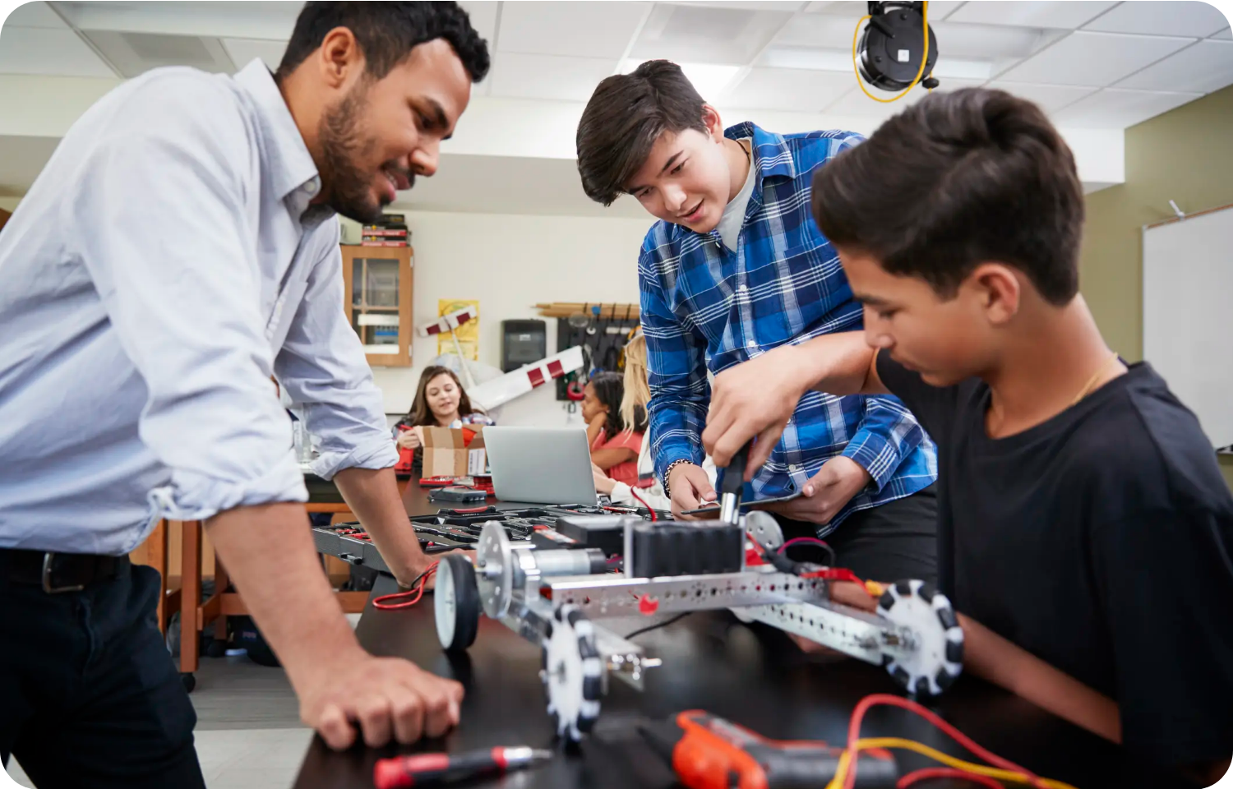






National Imperatives
EDUCATION & INVESTMENT STRATEGY
Reorienting Education
Focus on AI Engineering: Data, Models, and Systems.
Structured "AI Housemanship" (Applied Practice).
RAIN Curriculum: Ready for national scaling.
Local IP & Investment
Mobilize private wealth for local AI infrastructure.
Shift from Consumers to Owners of IP.
"Teaching people to use AI produces consumers. Teaching people to build AI produces an industry."
Evaluate partnerships on capacity transfer.
ROBOTICS AND ARTIFICIAL INTELLIGENCE NIGERIA (RAIN)
Dr. Olusola Ayoola · National Summit on AI & Robotics

Slide 9











Regulation & Sectoral Deployment
Establishing Ethical Standards and Driving National Productivity
Education
AI assessment tools, detecting learning gaps, and personalized feedback for millions.
Ethical Guardrails
Transparency & Bias Auditing
Healthcare
Specialist-level diagnostics at community centers and drug authentication systems.
Data Provenance Standards
NITDA Regulatory Framework
Accountability Protocols
Agriculture
Market-linkage, crop disease detection, livestock geofencing, and yield forecasting.
"A national AI strategy that does not begin with ethical standards is a document written in sand."

Slide 10







CONCLUSION
Our Debt to the Next Generation
Structural Intervention
Economic Sovereignty
Collective Will
AI is not just a tool; it is a way to bypass institutional failures and automate transparency.
We must be Producers of AI to avoid digital feudalism and dependency.
Investing in talent, data, and infrastructure before the returns become obvious.
THE MISSION
"AI will only serve Nigeria if we build it with our data, by our engineers, for our specific interests."
Dr. Olusola S. Ayoola
CEO/Founder, RAIN

